Slide 1
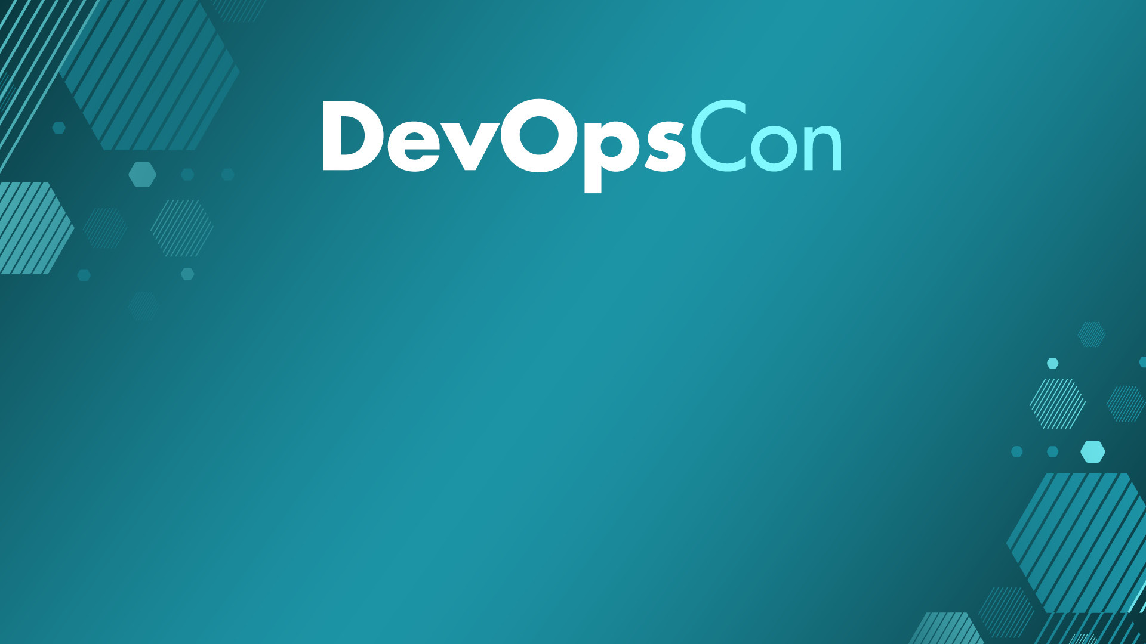
Let’s go Hybrid! Is it better? No. Is it cheaper? Yes!
Roberto Freato – Azure MVP / Author / CTO @Witailer

Slide 2

Disclaimer
Prices used in this presentation are only indications.
Actual pricing can depend on a huge variety of factors which are out of the scope of this session.
I’m not affiliated with any cloud/hosting provider.
In this session, the term “hybrid” is abused, to mean almost everything except single public cloud, like running multi-cloud, or running bare metal or even with a mix of an ARM-based K8S cluster on your desk. Sorry about that.

Slide 3

Do you know the cost of a core?
Per month, in the mainstream public cloud

Slide 4
30$ / month*
* details of calculation method and providers can be provided privately
“Major” public cloud

Slide 5
12$ / month*
* details of calculation method and providers can be provided privately
“Cheap” public cloud

Slide 6
8$ / month*
* details of calculation method and providers can be provided privately
Bare metal (managed)

Slide 7
To be honest about Main differences between providers
Provider | SLA | Network | Regions | Bandwidth
Major cloud | Always | Advanced | Many | Pay-per-use
Cheap cloud | Sometimes | Limited | Few | Pay-per-use (cheaper)
Bare metal (managed) | DIY | Basic / None | Few | Flat included

Slide 8
I started cloud-native
Notes:
Growing fast is a great fit for startups

Slide 9
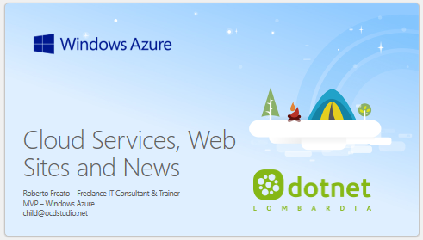
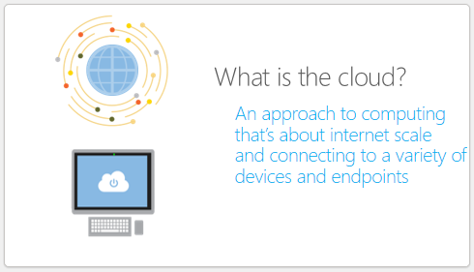
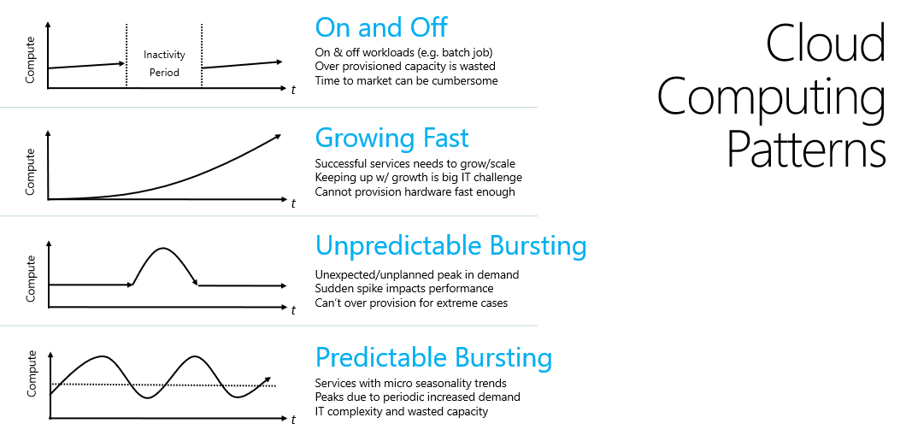
Let’s step back 11 years ago*
* Web.NET Conference @Milan – 10/20/2012

Slide 10
Not every company is a startup
tip #1
Notes:
Growing fast is a great fit for startups

Slide 11
On and Off
Cloud Computing Patterns
Inactivity
Period
On & off workloads (e.g. batch job)
Over provisioned capacity is wasted
Time to market can be cumbersome
Compute
t
Growing Fast
Compute
Successful services needs to grow/scale
Keeping up w/ growth is big IT challenge
Cannot provision hardware fast enough
t
Unpredictable Bursting
Compute
Unexpected/unplanned peak in demand
Sudden spike impacts performance
Can’t over provision for extreme cases
t
Predictable Bursting
Compute
Services with micro seasonality trends
Peaks due to periodic increased demand
IT complexity and wasted capacity
t

Slide 12
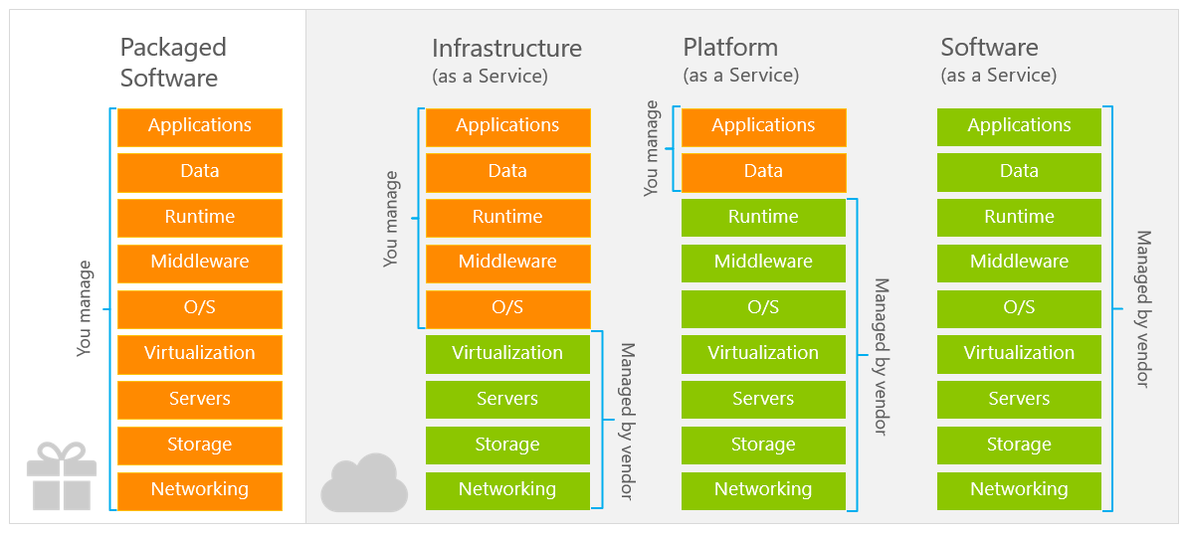

Slide 13
Focus on value*-added services
* value is very often represented by software
tip #2

Slide 14
Azure Functions
Azure Functions
Azure App Service
Cloud Services
WebJobs SDK
Serverless
Web Apps
WebJobs
Web Role
Worker Role

Slide 15
Why software adds value to the cloud
A set of VMs is just a set of VMs
A set of VMs with a managed installation of Elastic Search can be sold as a Search Service
A NAS is just a storage array
A NAS with a software layer providing an API on it can be sold as an Object Storage

Slide 17
App Service
Event Hub
SQL Database
Deploy web apps
Scale in seconds
Integrated build service
CronJobs
Kafka-like event processor
Multi-protocol
Persistent
SQL Server as a service
Backups, PITR
Scalable
Automatic tuning
some great paas
Notes:
Absolute vs Relative measurements
Gigs? TBs? Per day/month?
It is not a matter of complexity of the dataset itself, but the overall solution
Some sources can be trusted, some others not

Slide 18
Synapse
Container Instances/Apps
Azure AD/B2C
Single point for a Data solution
Spark integration
Pipelines
Data lake
Data warehouse
Docker runner as a service
Scalable on events
Ready-to-go
IAM as-a-service
Billed on Users/MAU
Multi-protocol
some great paas (2)
Notes:
Absolute vs Relative measurements
Gigs? TBs? Per day/month?
It is not a matter of complexity of the dataset itself, but the overall solution
Some sources can be trusted, some others not

Slide 19
Logic Apps
Storage
API Management
Workflow management
Many ready-to-use connectors
Billed on consumption
Indefinite-scalable archive
Multi-protocol
API Router/Proxy
Access Control
Cache
Versioning
Developer portal
some great paas (3)
Notes:
Absolute vs Relative measurements
Gigs? TBs? Per day/month?
It is not a matter of complexity of the dataset itself, but the overall solution
Some sources can be trusted, some others not

Slide 20
Should we avoid to buy PaaS?

Slide 21
Learn how the Cloud does
tip #3
Notes:
Growing fast is a great fit for startups

Slide 22
Some examples
Implement multi-tenancy by design, always
As cloud providers do with your services
Automate every resource creation
By learning the provisioning technology
Focus on optimization and cost-efficiency
As you did with public utilities
Reduce complexity of applications
By forcing you to simplify your apps to fit PaaS

Slide 23
Expected results
Implement multi-tenancy by design, always
You will have fewer deployments, easier upgrade/updates
Resource pooling
Automate every resource creation
You will learn to provision stuff with code/scripting
And you will never come back, either on-prem
Focus on optimization and cost-efficiency
A better algorithm will save money in the cloud
You will keep this learnings with you after it
Reduce complexity of applications
Most of PaaS needs application constraints to run
Those constraints are often good in general in most of the systems

Slide 24
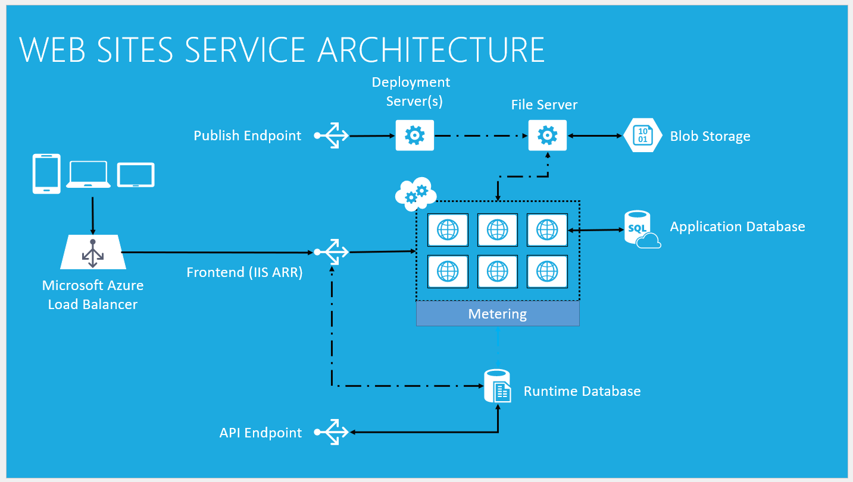

Slide 25
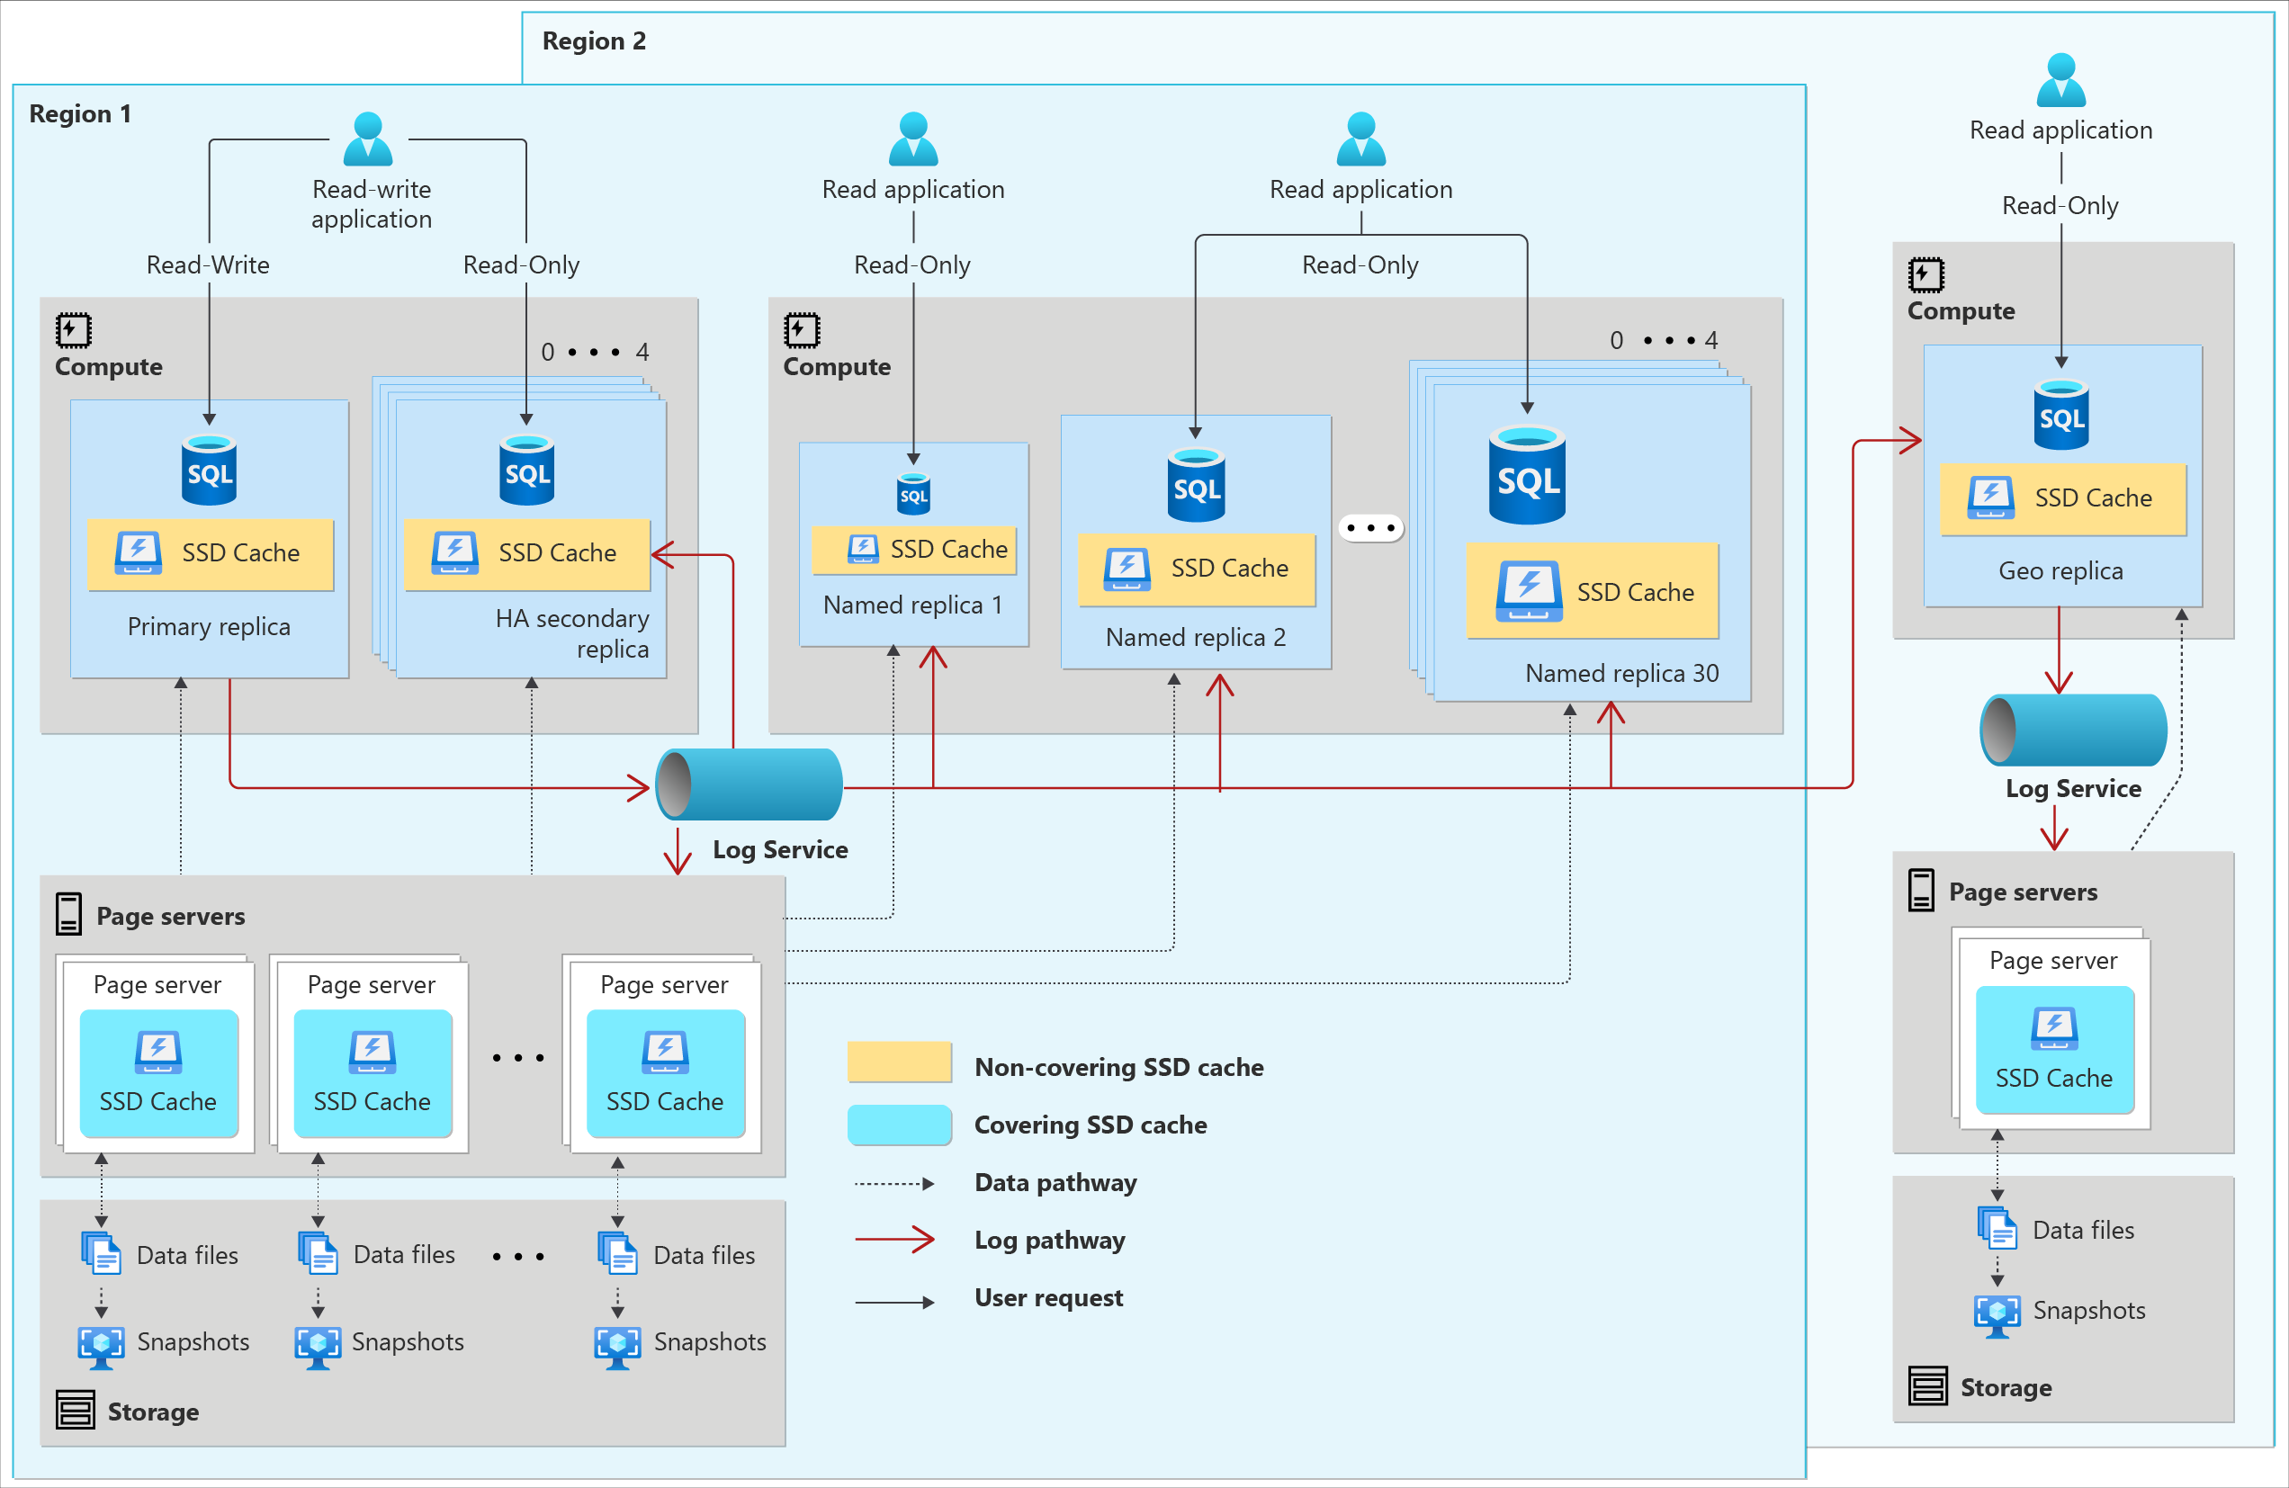

Slide 26
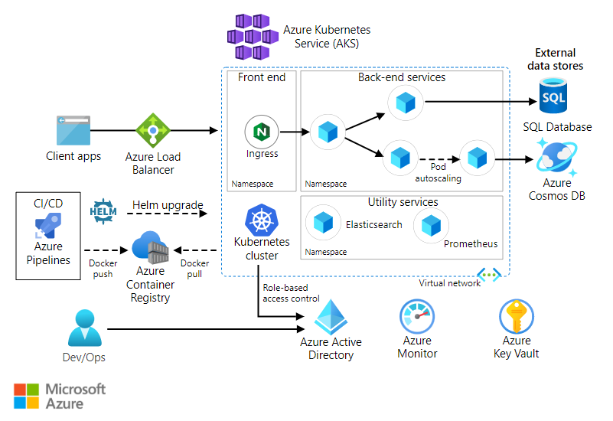

Slide 27
State is the real game changer
tip #4
Notes:
Growing fast is a great fit for startups

Slide 28
Do you know the cost of a TB?

Slide 29
The cost of writing, holding and reading 1TB (10M files) Take decision with the appropriate information
Access | Frequent | Infrequent | Long-term
Rest | 20 | 10 | 2
Write (10M files) | 54 | 100 | 120
Read (10M files) | 4 | 10 | 6000
Retrieve | 0 | 10 | 24
 | 78 | 130 | 😐

Slide 30
80$ to get out*
* details of calculation method and providers can be provided privately
Know the lock-in

Slide 31
Identify the lock-in(s)
tip #5
Notes:
Growing fast is a great fit for startups

Slide 32
Five shades of lock-in
Getting out of a service can cost a lot
The complexity of a service is too hard to manage it directly
The PaaS/SaaS required custom implementation to fit in
The service represents a really “unique” solution in the market
The individual costs of some services are so “low”

Slide 33
Vital few
Services running 80% of the budget
Try to be locked in (only) here
the cloud services pareto rule

Slide 34
Build your hybrid-PaaS (or die trying)
tip #6
Notes:
Growing fast is a great fit for startups

Slide 35
1) Storage
Is that storage your primary storage?
Do you need HA (high availability)?
Which kind of scalability do you need?
Do you need an object storage?

Slide 36
2) Database
Is that storage your primary storage?
Do you need HA (high availability)?
Which kind of scalability do you need?
Are you able to properly setup and tune the software?
And maintain it along time?
Do you need exactly that RDBMS technology?

Slide 37
3) Specialized NoSQL
Is that storage your primary storage?
Do you need HA (high availability)?
Which kind of scalability do you need?
Are you able to properly setup and tune the software?
And maintain it along time?

Slide 38
Focus on enhanced MTTR (mean-time-to-repair / restore / rebuild)
tip #7
Notes:
Growing fast is a great fit for startups

Slide 39
4) Worker roles
Does your job create new state?
Can you write it in a host-aware technology (i.e. Docker)?
Can you plug a sidecar in your code?
Is it a microservice?

Slide 40
5) Web roles
Does your code create new state?
Do you need to scale your web?
How do you plan to manage TLS?
What about the deployments?

Slide 41
6) Integration services
Are your datasets heavy or light?
Are the connectors and pipelines quite stable?
Is your architecture event-driven?

Slide 42
Buy something you need, not in the case you needed
tip #8
Notes:
Growing fast is a great fit for startups

Slide 43
Not in the checklists
Networking
Virtual Networks
VPNs
Load Balancers
Reverse proxies
Identity Management
All-in-one low-cost services
Container registries
Git repositories
KMS
Productivity SaaS
DevOps platforms
…

Slide 44

Bonus
Azure Arc

Slide 45
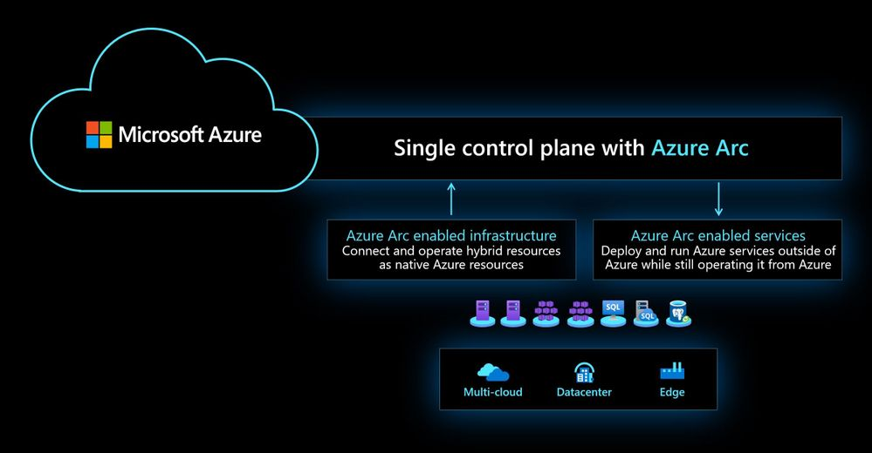

Slide 46
Integration options
Arc-enabled servers
Connects any Windows/Linux machine to the Arc bridge
Arc-enabled Kubernetes
Extends any CNCF-certified K8S clusters features
Arc-enabled data services
Implements a managed SQL Server and PostgreSQL
Arc-enabled SQL Server
Centralizes the point of control of all you SQL instances
Arc-enabled SCVMM
Provisions and integrates the various resources into Azure
Arc-enabled VMware vSphere
Provisions and integrates the various resources into Azure
Arc-enabled Azure Stack HCI
Provisions and integrates the various resources into Azure

Slide 47
Benefits
Centralized point of administration
Azure RBAC & Policies
VM Extensions: logging, security, custom
Data Services in your environment
Management of new instance provisioning
Governance of existing SQL Server infrastructure
And Kubernetes?

Slide 48
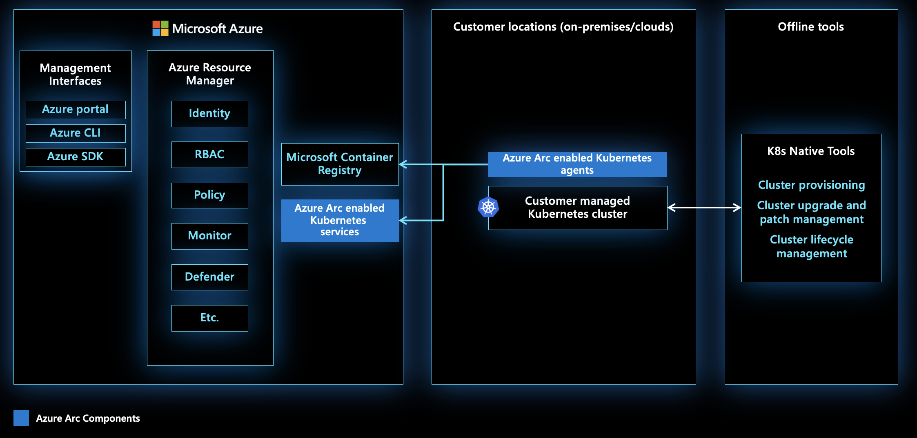

Slide 49
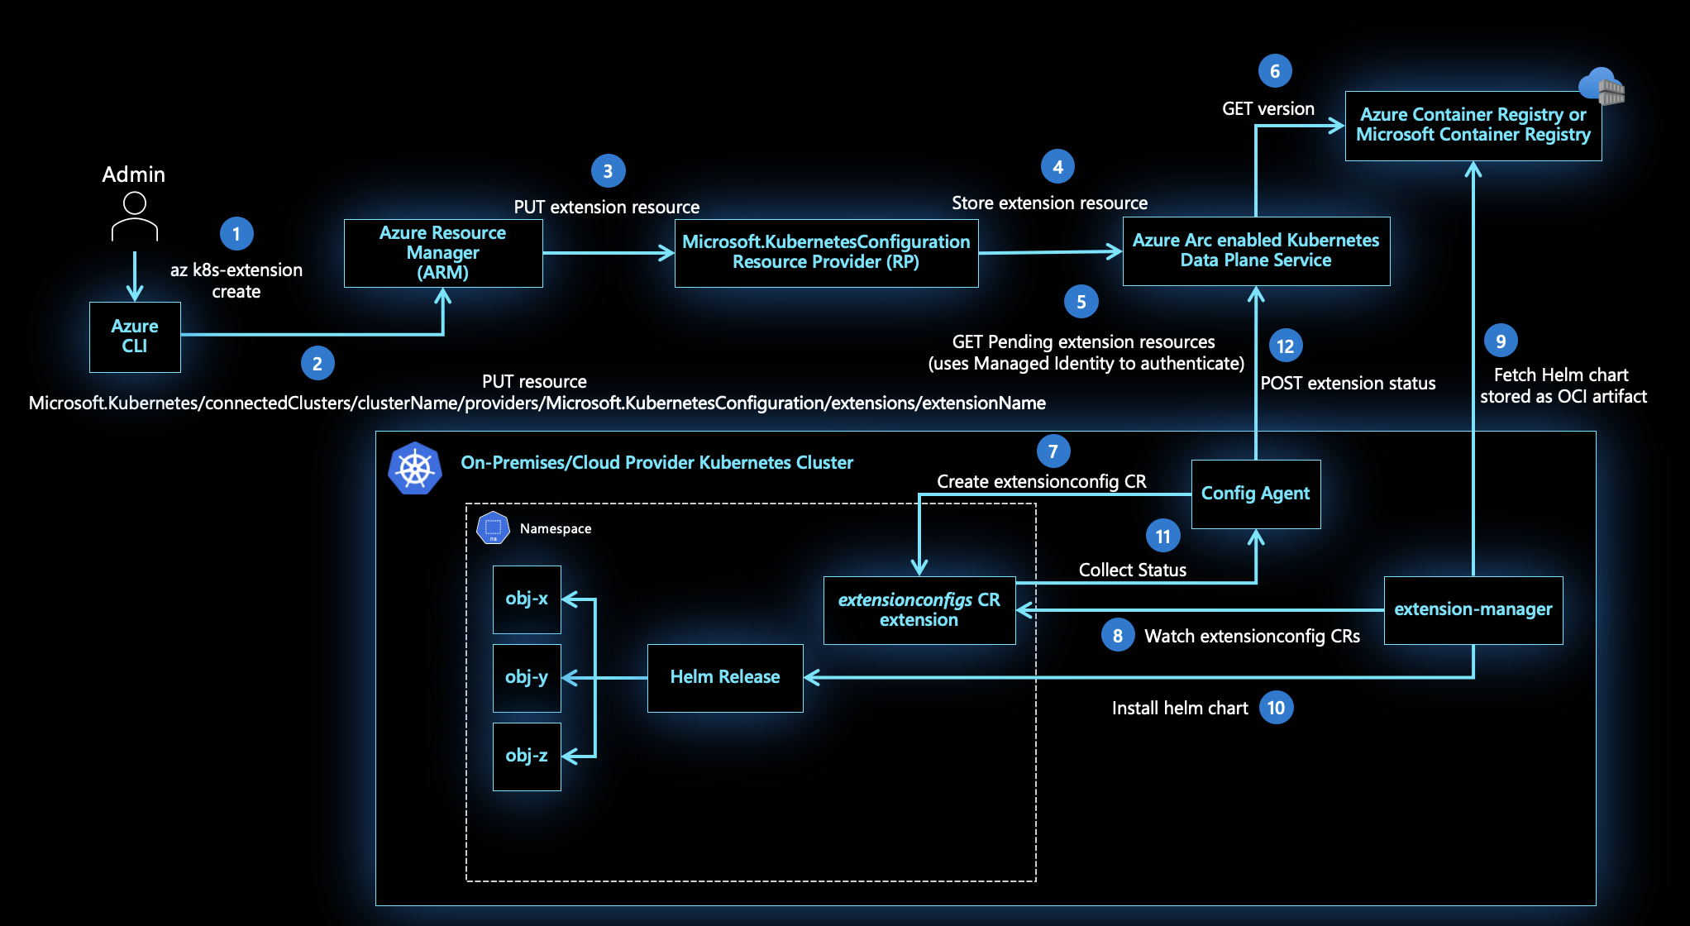
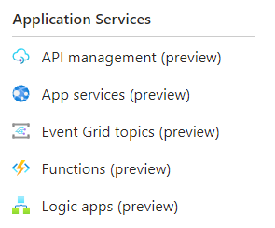

Slide 50
Don’t forget the bandwidth
tip #9
Notes:
Growing fast is a great fit for startups

Slide 51

And what about the environment?
The path to green software

Slide 52
Hybrid workloads
Sustainability
common
side-effect

Slide 53
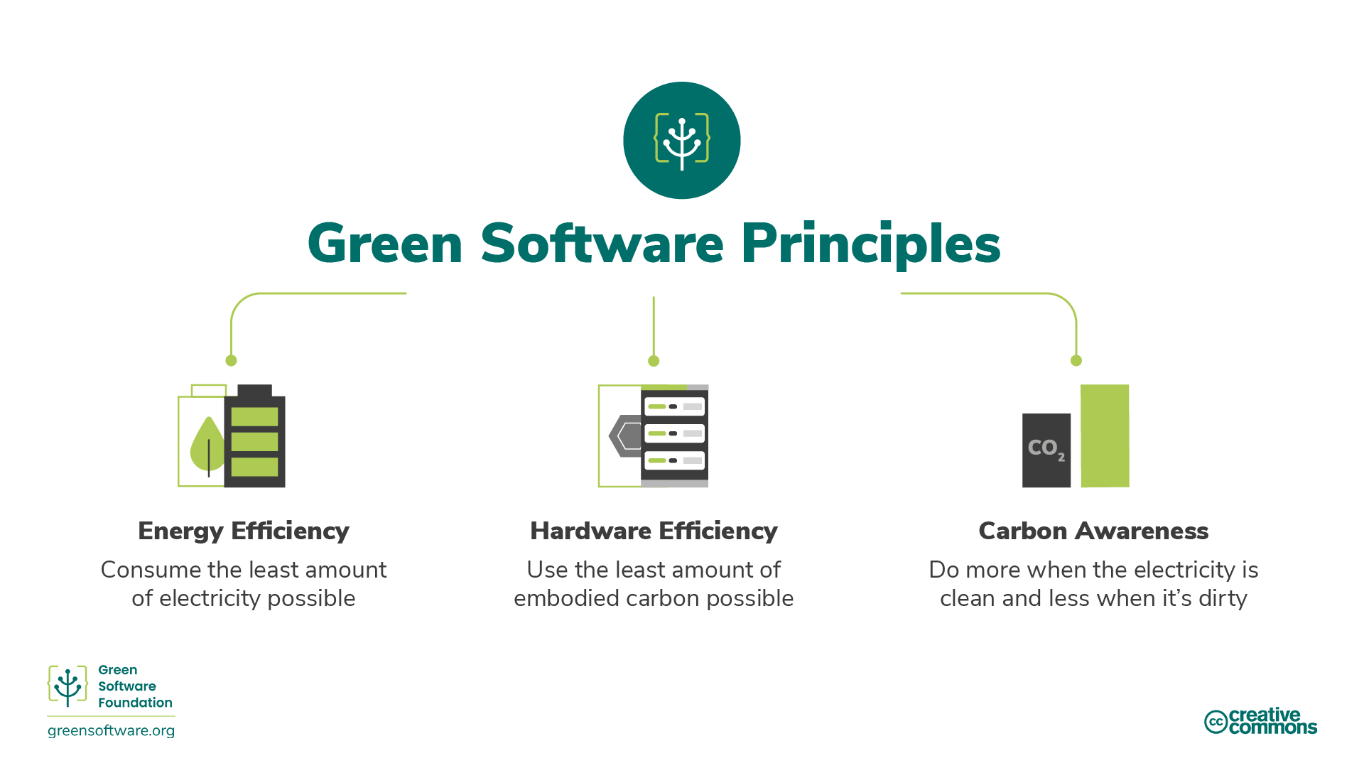

Slide 54
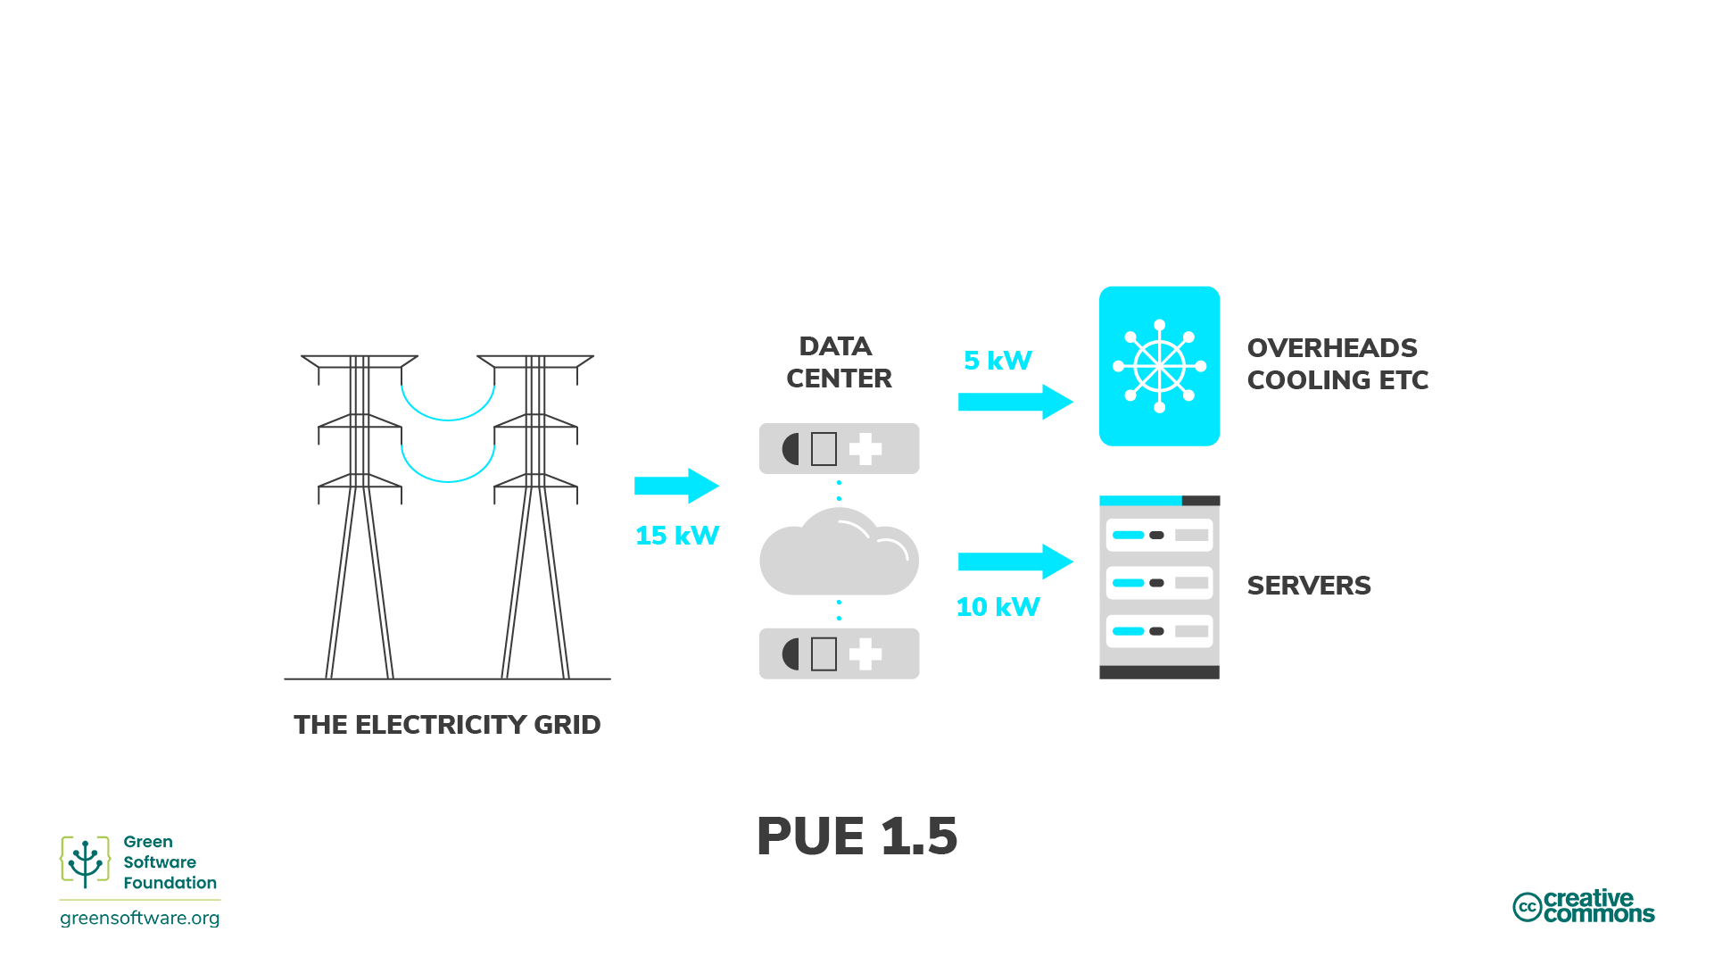

Slide 55
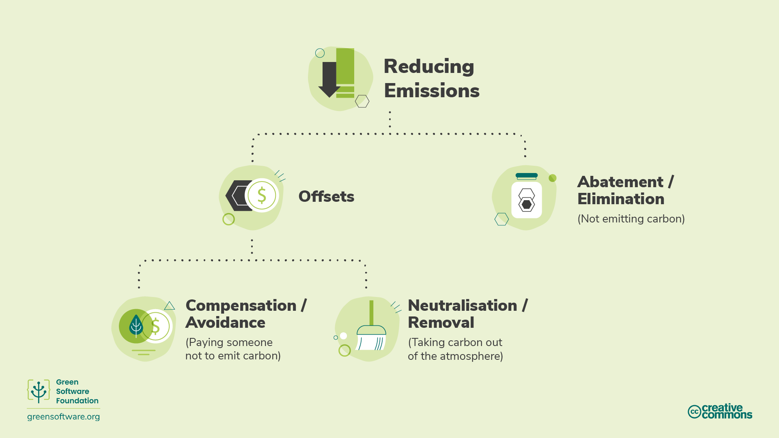

Slide 56
Few references
MinIO | High Performance, Kubernetes Native Object Storage
KEDA | Kubernetes Event-driven Autoscaling
Azure Arc – Hybrid and Multi-Cloud Management and Solution (microsoft.com)
Quickstart: Deploy a SQL Server container with Azure Kubernetes Services (AKS) - SQL Server | Microsoft Learn
Green Software Foundation | GSF

Slide 57
Takeaways
Choose your split between make or buy
Deactivate some expensive services in favor of hybrid
Upskill your team to provide PaaS directly
Keep track and compare the differences to validate your model
Remember the importance of the state
Always discuss solutions and keep in mind the environment

Slide 58

Questions?

Slide 59
Thanks!
Roberto Freato – Azure MVP / Author / CTO @Witailer

